Slide 1
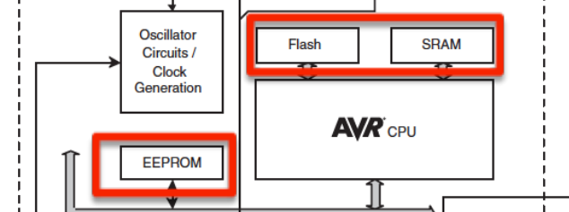
MEMORY
Flash (32K)
Program memory – read only
Non-volatile
SRAM (2K)
Temporary values, stack, etc.
Volatile
Limited space!
EEPROM (1K)
For long-term data

Slide 2
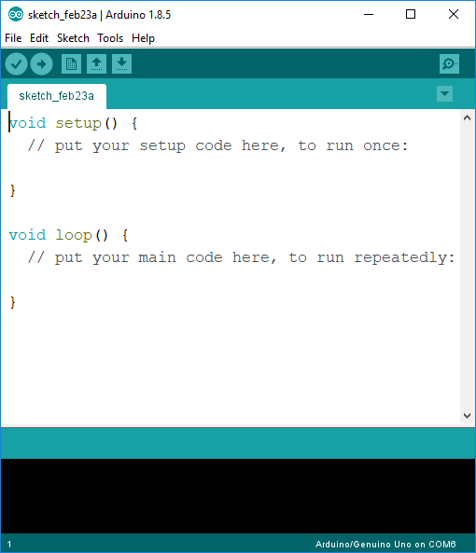
ARDUINO IDE
Verify
Serial Monitor
Upload
Text Editor
Arduino Type and Port
Console Log

Slide 3
Arduino programs can be divided in three main parts:
structure, values (variables and constants), and functions.
Structure
- setup, loop
- if, if…else, for, switch case…
Values
- Constants: HIGHT|LOW…
- Data types: void, char…
Functions
- Digital I/O
- Analog I/O
…..
More:
https://www.arduino.cc/en/Reference/HomePage

Slide 4
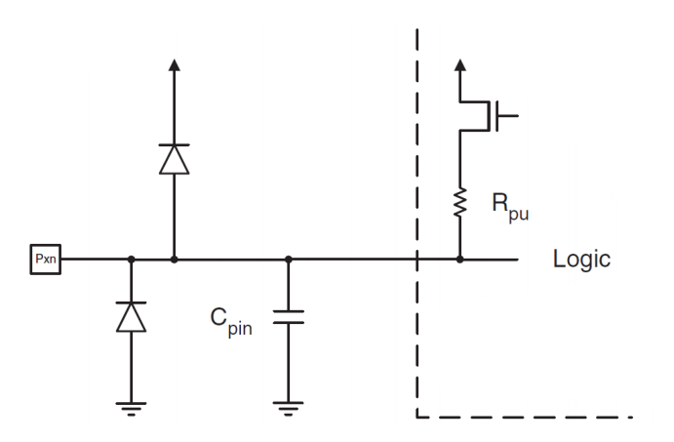
I/O port pins and their functions
20 General Purpose Digital I/O Pins
Output: 20 mA
Input with or without a pull-up resistors. (20-50Kohms)
Each I/O pin has clamping diodes to protect input circuit from undervoltage/overvoltage and ESD conditions.

Slide 5
pinMode(pin, mode)
Description
Configures the specified pin to behave either as an input or an output.
Parameters
pin: the number of the pin whose mode you wish to set (0->13, A0 -> A5)
mode: INPUT, OUTPUT, or INPUT_PULLUP.
Returns
Nothing

Slide 6
digitalWrite(pin, value)
Description
Write a HIGH or a LOW value to a digital pin.
Parameters
pin: the pin number
value: HIGH or LOW
Returns
Nothing

Slide 7
digitalRead(pin)
Description
Reads the value from a specified digital pin, either HIGH or LOW.
Parameters
pin: the number of the digital pin you want to read
Returns
HIGH or LOW

Slide 8
delay(ms)
Description
Pauses the program for the amount of time (in milliseconds)
Parameters
ms: the number of milliseconds to pause (unsigned long)
Returns
Nothing

